Slide 1
Project Moonbank
GCP Acceleration Program – group 2
Forrest cai, max luo, Michael sun, victor lu, Vincent zeng

Slide 2
background
This is the artifact of Project Moonbank design as one course for GCP acceleration program
….

Slide 3
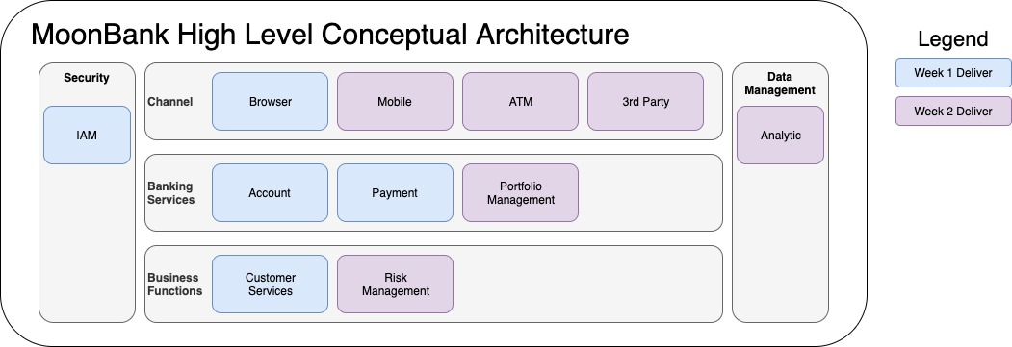
Conceptual architecture

Slide 4
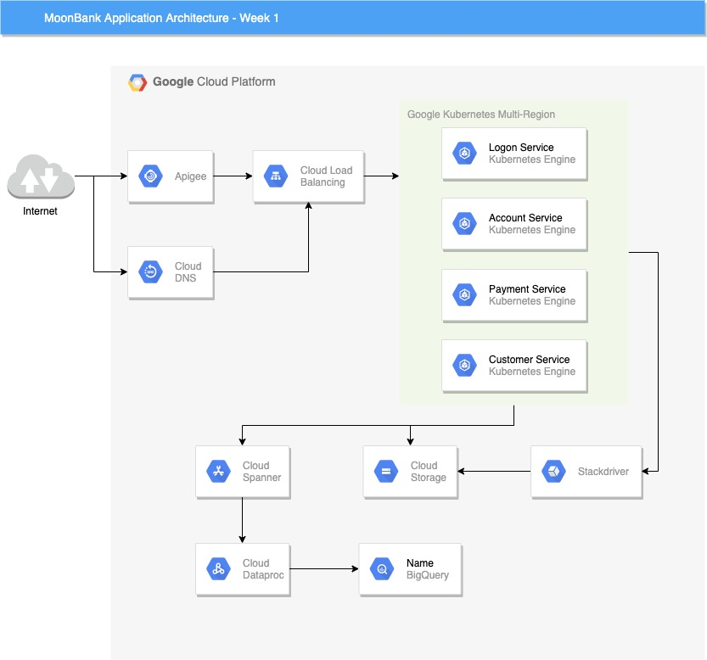
Application architecture
Decision Points:
PROS
CRONS

Slide 5
Web app infrastructure

Slide 6
Storage infrastructure – customer contact

Slide 7
Storage infrastructure – transaction

Slide 8
Storage infrastructure – reconciliation

